Slide 1
Priority
Category Partitioning Testing Tool
OOPT 2nd Cycle
OOPT
2nd
Cycle
Team 4
201311265 김상원 201311269 김제헌 201311297 이상명 201210194 김정환

Slide 2
Team4 Presentation Index
OOPT 2nd Cycle
1. TEAM 2 | PMD Warnings
 | Metrics Report
 | FindBugs
2. TEAM 3 | PMD Warnings
 | Metrics Report
 | FindBugs

Slide 3
Team 2
PMD Warnings
Team 2 PMD Warnings

Slide 4


Client
AdminProject.java
Team 2 PMD Warnings
AdminUser.java
AdminVer.java

Slide 5
Server
AdminProject.java
Team 2 PMD Warnings
AdminUser.java
MainServer.java
ServerThread.java

Slide 6
Team 2
Metrics Report
Team 2 Metrics Report

Slide 7
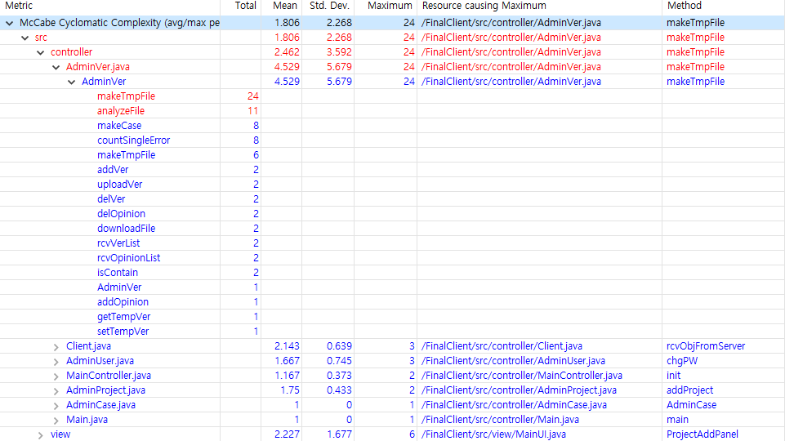
Client
Team 2 Metrics Report
Cyclomatic complexity

Slide 8
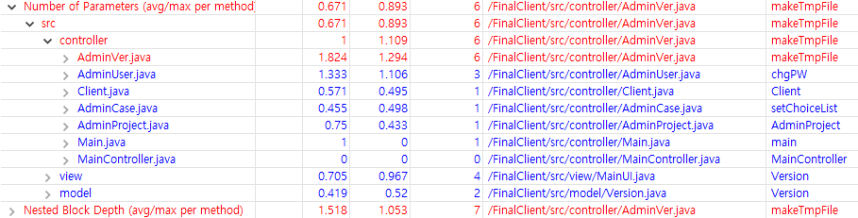
Client
Team 2 Metrics Report
Number of Parameters

Slide 9
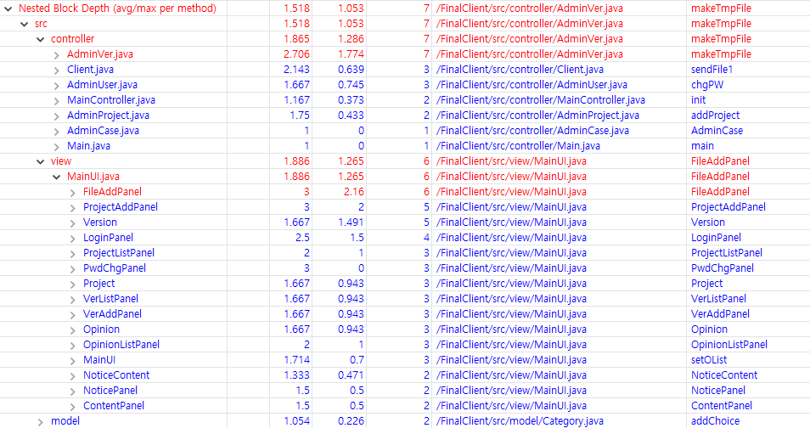
Client
Team 2 Metrics Report
Nested Block Depth

Slide 10
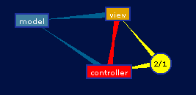
Client
Team 2 Metrics Report
Dependency Graph View

Slide 11
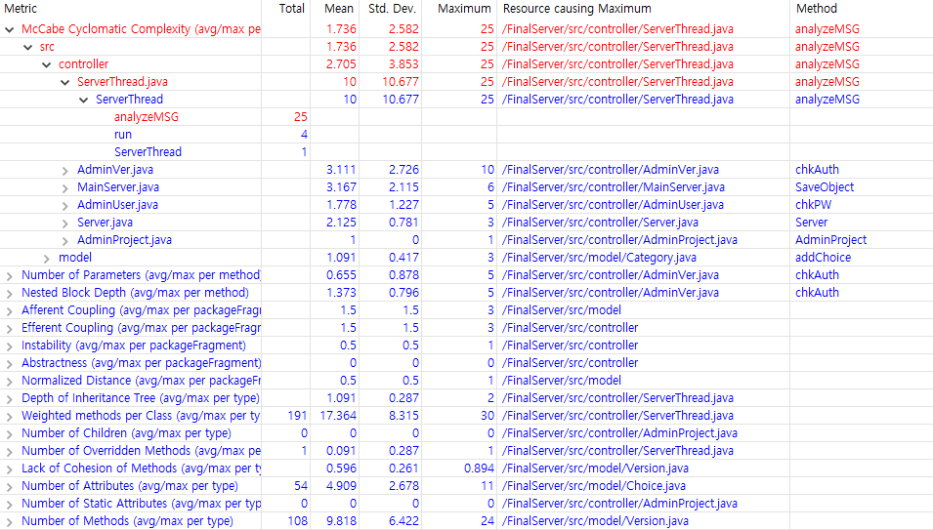
Server
Team 2 Metrics Report
Cyclomatic complexity

Slide 12
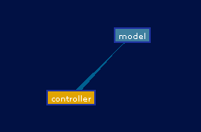
Server
Team 2 Metrics Report
Dependency Graph View

Slide 13
Team 2
FindBugs
Team 2 FindBugs

Slide 14
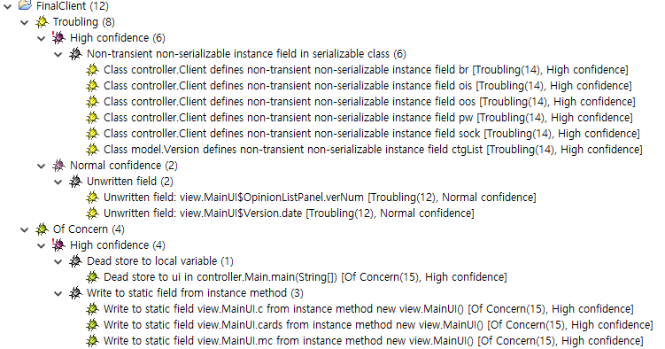
FinalClient
Team 2 FindBugs

Slide 15
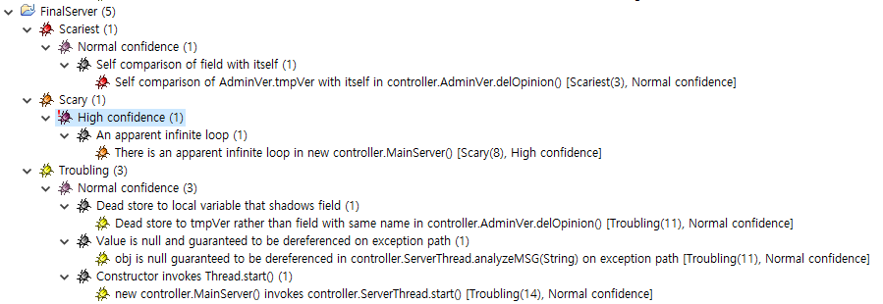
FinalServer
Team 2 FindBugs

Slide 16
Team 3
PMD Warnings
Team 3 PMD Warnings

Slide 17
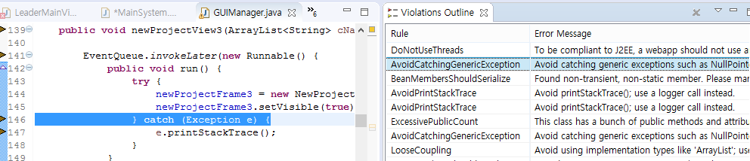
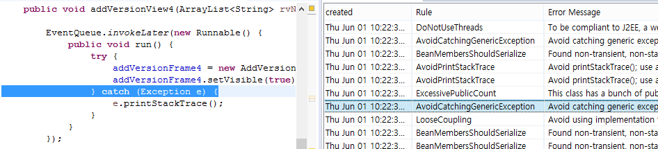
Control.GUIManager.newProjectView3
Team 3 PMD Warnings
Control.GUIManager.newProjectView4

Slide 18
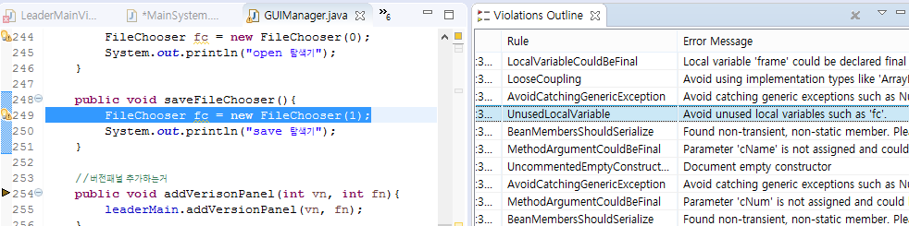
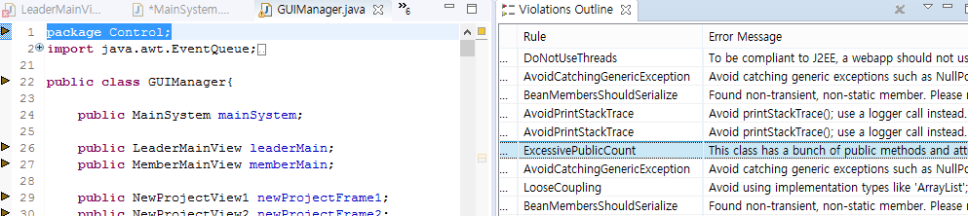
Control.GUIManager.saveFileChooser
Team 3 PMD Warnings
Control.GUIManager

Slide 19
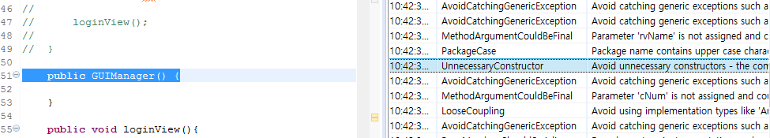
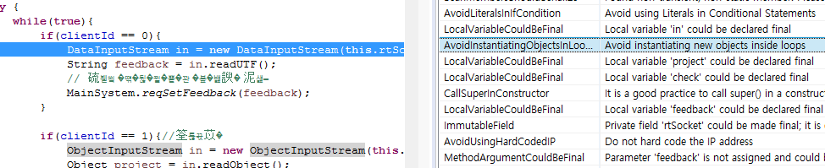
Control.GUIManager.GUIManager
Team 3 PMD Warnings
Control.ReceiveThreadInNetworkManager.run

Slide 20
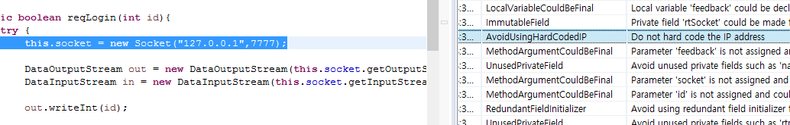
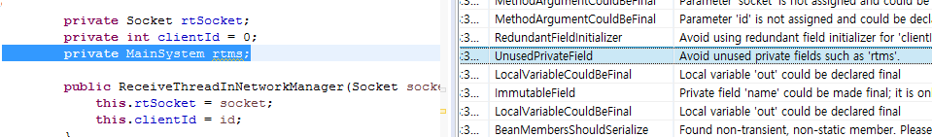
Control.NetworkManager.reqLogin
Team 3 PMD Warnings
Control.ReceiveThreadInNetworkManager

Slide 21
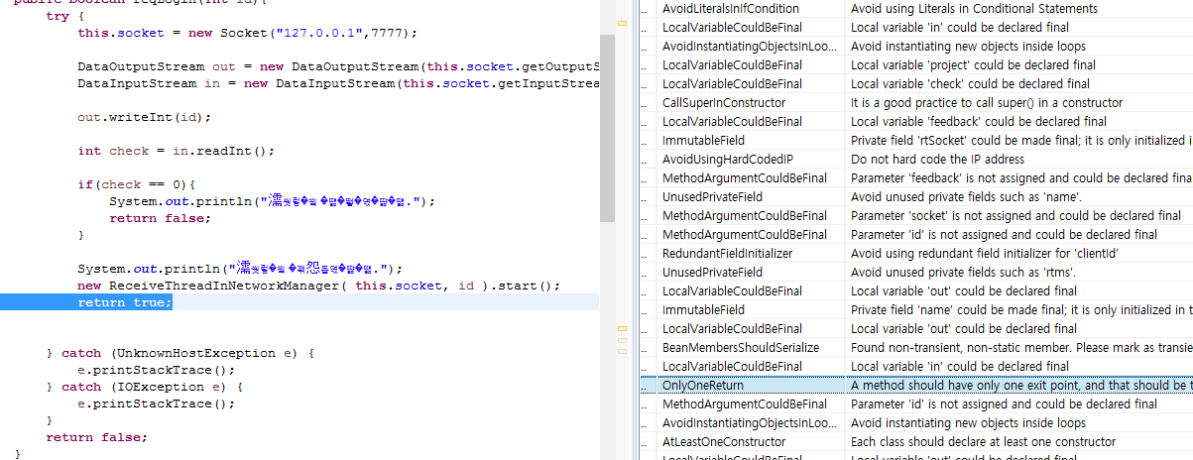
Control.NetworkManager.reqLogin
Team 3 PMD Warnings

Slide 22
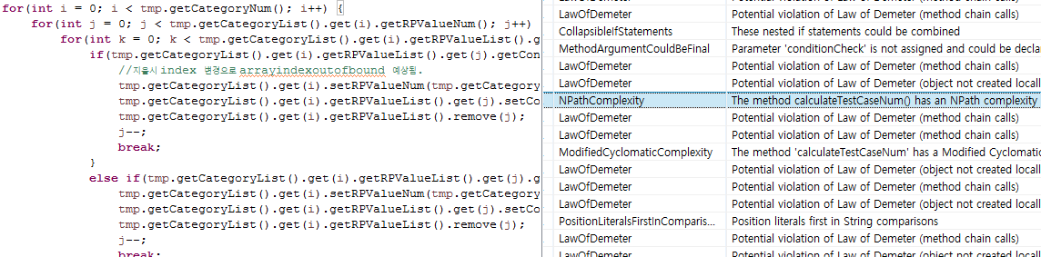
Control.ResultManager.calculateTestCaseNum
Team 3 PMD Warnings

Slide 23
Team 3
Metrics Report
Team 3 Metrics Report

Slide 24
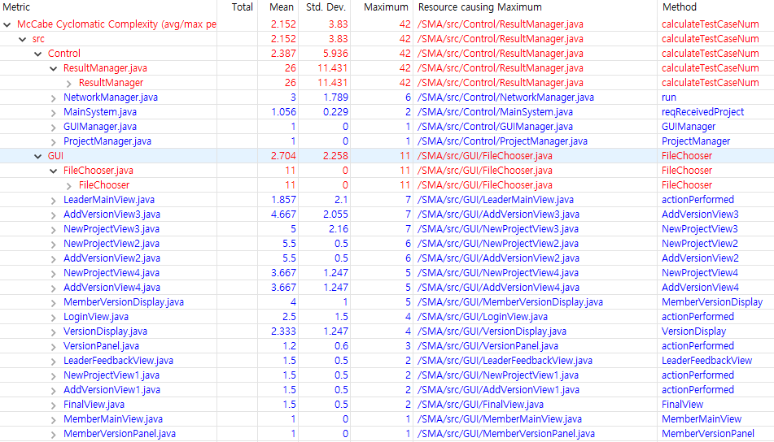
Team 3 Metrics Report
Cyclomatic complexity

Slide 25
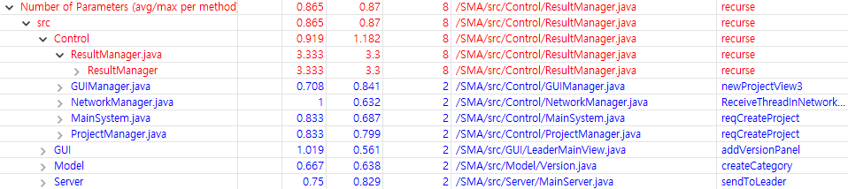
Team 3 Metrics Report
Number of Parameters

Slide 26
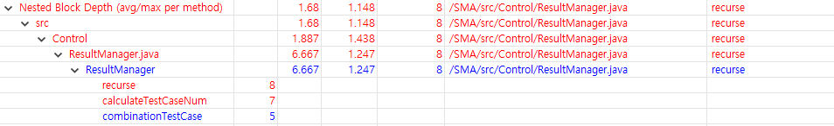
Team 3 Metrics Report
Nested Block Depth

Slide 27
Team 3
FindBugs
Team 3 FindBugs

Slide 28
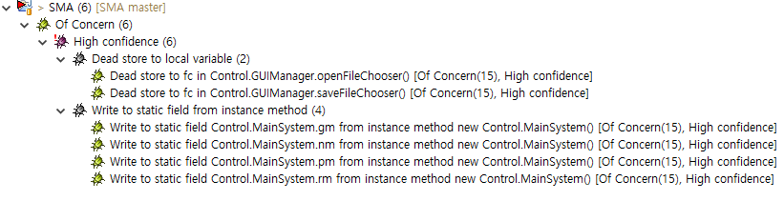
Team 3 FindBugs

Slide 29
OOPT 2nd Cycle
Q & A

Slide 30
OOPT 2nd Cycle
Thank you!

